Slide 1
NC Department of Health and Human Services
Unintentional
Fall Injuries in
North Carolina
NC Division of Public Health
Data updated

Slide 2
Unintentional Falls Technical Notes
Surveillance methods have been updated to identify any mention of an injury in our morbidity data sources. Individual records with multiple injuries listed will be included in the total for each of those injuries, but only counted once for overall total injury count. Previously, only the first listed injury was counted, which has resulted in an increase in the number of specific injuries identified.
For questions or for more information see technical notes document available at https://www.injuryfreenc.ncdhhs.gov/DataSurveillance/
Case definitions used:
Deaths – ICD10 code W00-W19 listed as cause of death

Slide 3
Technical Notes, Continued
Hospitalizations – Among records with an ICD-10-CM injury code*, any mention of the following ICD-10-CM codes (includes records resulting in death)
Emergency Department Visits – Any mention of the following ICD-10-CM codes: (includes records resulting in hospitalization or death)
V00.11-V00.89 with 6th character=1 | Falls related to pedestrian conveyance
W00-W15, W17, W19 | Falls
W16 with 6th character=2 (Except 16.4 and 16.9 with 5th character=2) | Fall, jump, or diving into water
W18.1, W18.2, W18.3 | Other falls
7th character of A or missing (reflects initial encounter, active treatment)
*See technical notes document for a full list of ICD-10-CM injury diagnosis codes

Slide 4
The populations most at risk of falls are projected to have the fastest growth over the next 20 years.
Notes:
Number of counties with more people ages 60 and over than those ages 0-17 will increase from 80-95 over this time-frame, all but 5 counties (Harnett, Hoke, Cumberland, Onslow, and Craven)!

Slide 5
Most older adults in NC are non-Hispanic white
*Non-Hispanic

Slide 6
Demographic characteristics among older adults in North Carolina
of housing units with people 65 and older are single person households

Slide 7
Disability among adults 65 and older

Slide 9
Proportion of demographic groups reporting two or more falls in the last 12 months,

Slide 10
Unintentional fall-related deaths are the tip of the iceberg
Deaths
Despite NC’s excellent reporting systems, the total burden of fall injury in the state
is unknown.
Hospitalizations
ED Visits
? EMS
? Outpatient Visits
? Medically Unattended Injuries
INJURY ICEBURG

Slide 11

Unintentional Fall
Deaths

Slide 12
Unintentional fall-related deaths have continued to increase over the last 10 years

Slide 13
Unintentional falls were the leading cause of injury death* from
* by mechanism and intent

Slide 14
Unintentional falls were the cause of injury death among older adults*
* Adults ages 65 and older

Slide 15
Unintentional fall death rates are highest among those ages 75 and older
Rates begin increasing among ages 45-54
*Rate suppressed due to count being less than 5

Slide 16
Most fall-related deaths occurred among

Slide 17
Rates of fall-related deaths were highest among
NH – non-Hispanic; Rate not calculated for Other, NH

Slide 18
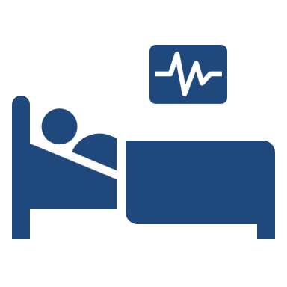
Unintentional Fall
Hospitalizations

Slide 19
Unintentional fall-related hospitalizations increased by over the last four years

Slide 20
of fall-related hospitalizations occurred among adults 65 and older

Slide 21
Adults 75 and older have the highest rates of fall-related hospitalizations

Slide 22
Most fall-related hospitalizations occurred among
NH – non-Hispanic

Slide 23
Fall-related hospitalization rates were highest among
; NH – non-Hispanic; Rate not calculated for Other, NH

Slide 24

Unintentional Fall
Emergency Department Visits

Slide 25
Unintentional fall-related ED visits increased by over the last four years

Slide 26
of fall-related ED visits occurred among adults 65 and older

Slide 27
Adults 75 and older have the highest rates of fall-related ED Visits

Slide 28
Most fall-related ED visits occurred among
NH – non-Hispanic

Slide 29
Rates of fall-related ED visits were highest among
; NH – non-Hispanic; Rate not calculated for Other, NH

Slide 30
Leading diagnosis codes for fall-related ED Visits

Slide 31
Summary of unintentional fall-related injuries in North Carolina
From , unintentional fall-related injuries resulted in:
  deaths
  hospitalizations
  emergency department visits
Most falls occur among females and Non-Hispanic whites
Rates of fall-related injuries are highest in the 75-84 and 85 and older age groups

